Slide 1


ISDS 552 GP3
TEAM MEMBERS:
DEEPAM KHIRWAR
HARSHITA DIDWANIA
KAVINDU WALIMUNIGE
SANCHIT SINGH
SATHIYA PRIYA JEEVANANDAN

Slide 2
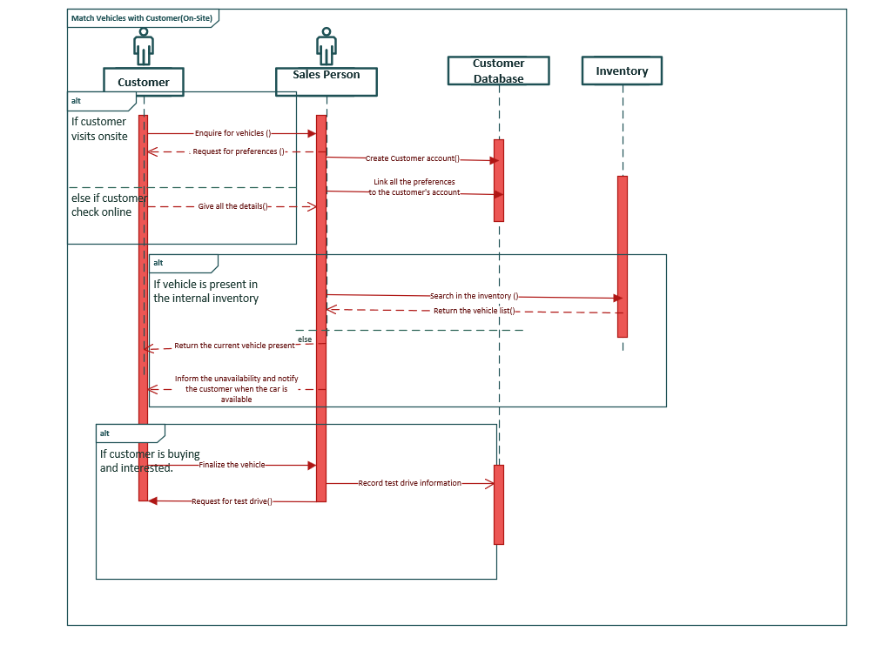
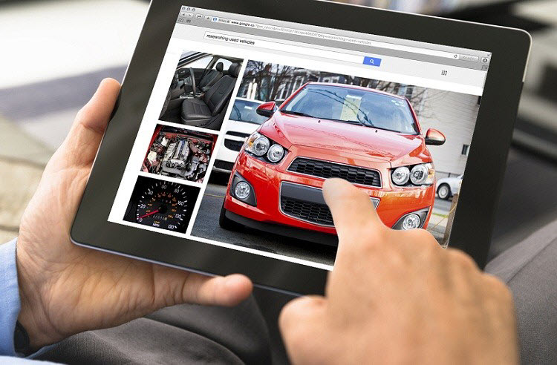
SEQUENCE DIAGRAM
MATCH CUSTOMER WITH VEHICLES

Slide 3
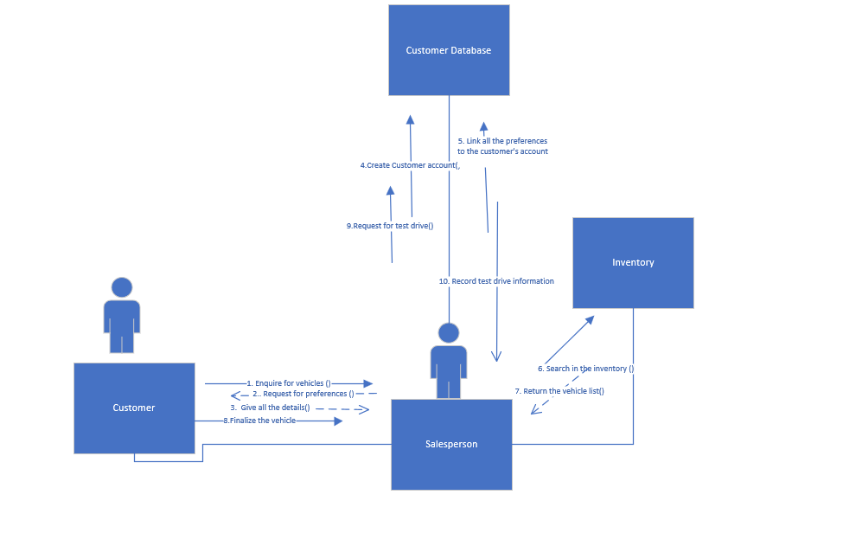
COMMUNICATION DIAGRAM
MATCH CUSTOMER WITH VEHICLES

Slide 4
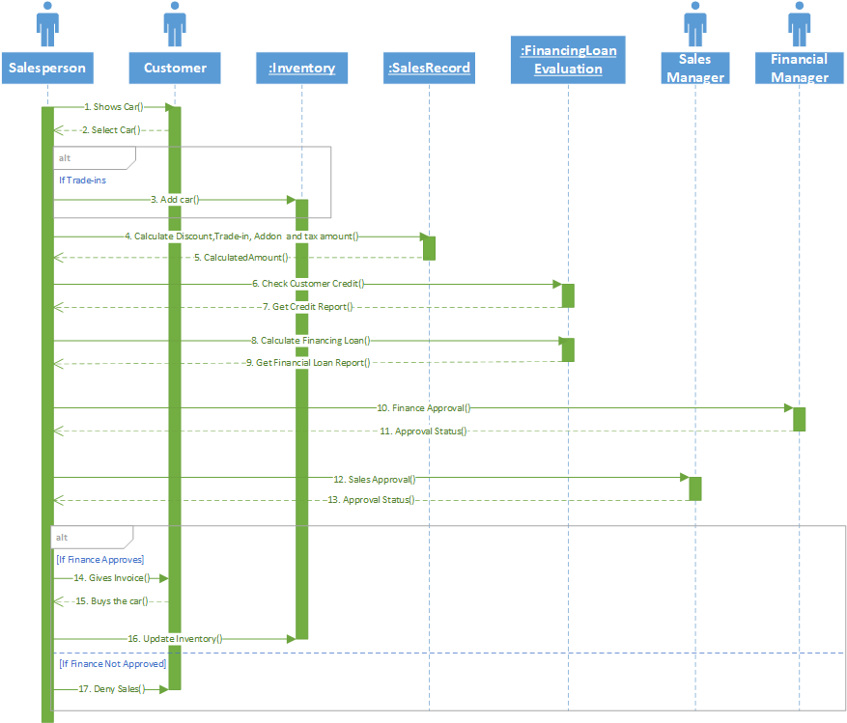

SEQUENCE DIAGRAM SELL CAR

Slide 5
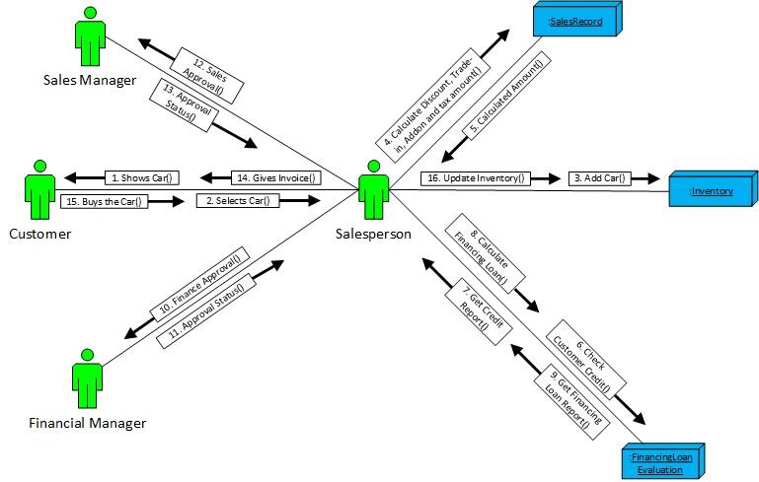
COMMUNICATION DIAGRAM SELL CAR

Slide 6
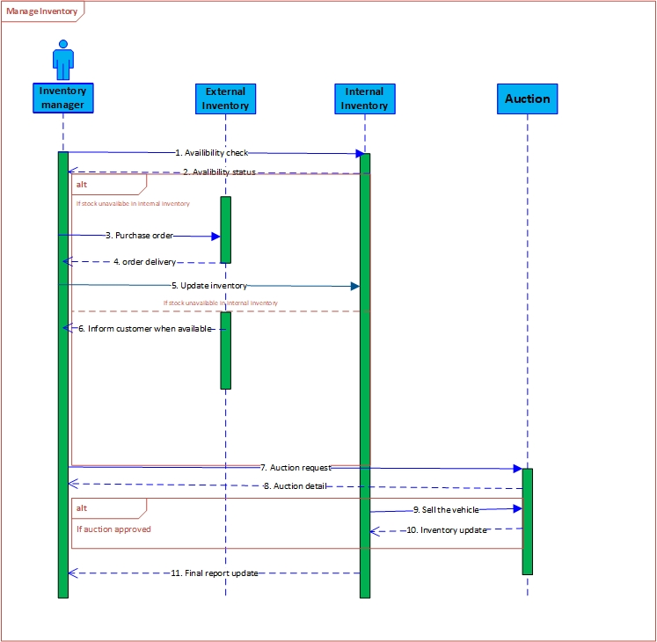

Sequence Diagram – Managing Inventory

Slide 7
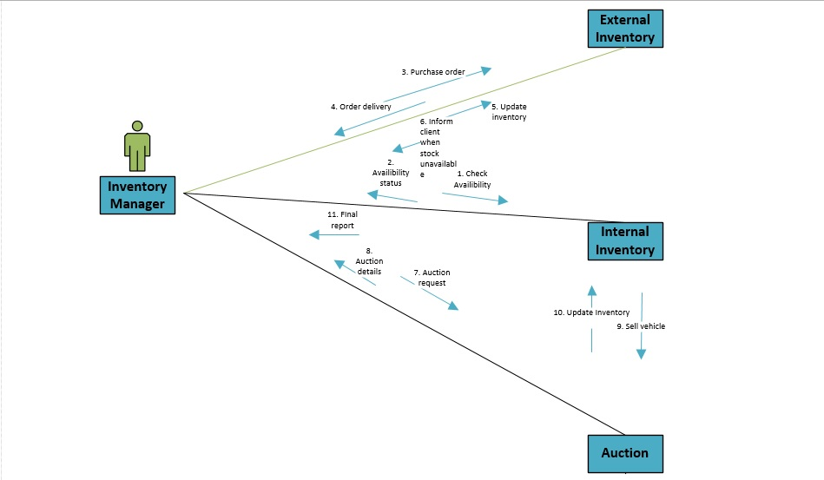
Communication Diagram – Managing Inventory

Slide 8
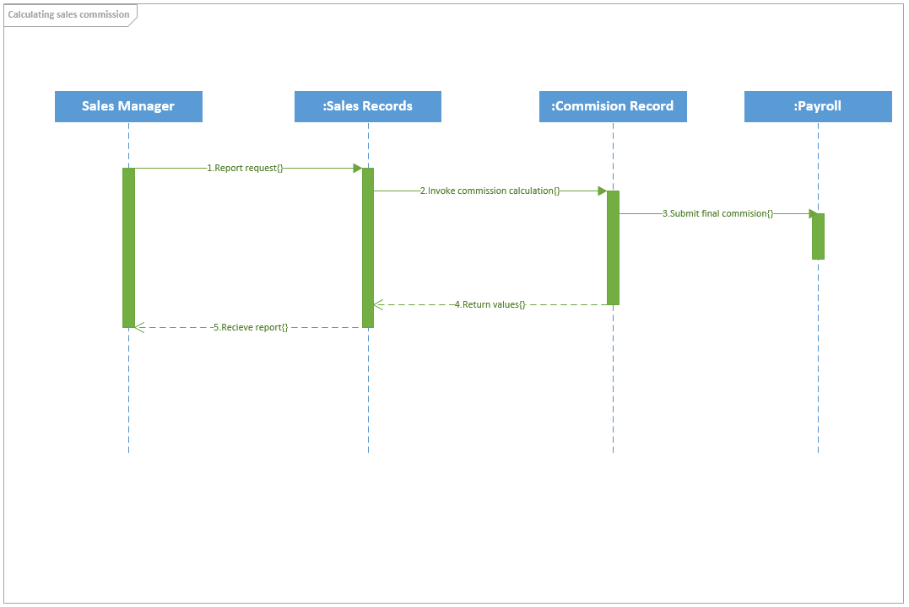


SEQUENCE DIAGRAM SALES COMMISSION

Slide 9
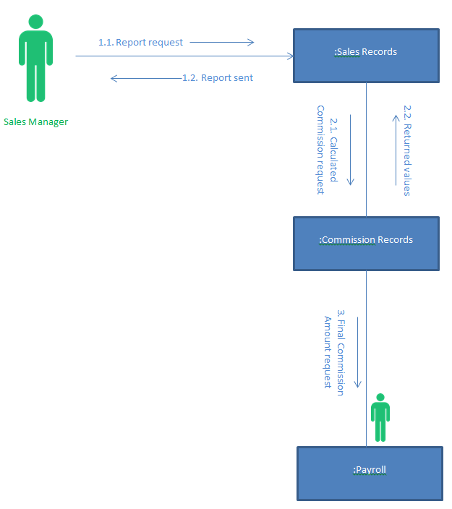
COMMUNICATION DIAGRAM SALES COMMISSION

Slide 10
Thank you!

